Slide 1
NE 795: Advanced Reactor Materials
Fall 2023
Dr. Benjamin Beeler

Slide 2
Last Time
Carbides have high fissile density and high thermal conductivity
He-bonded and Na-bonded designs for liquid metal or gas cooled reactors
Higher swelling and lower FGR than oxide fuels
Two primary phases: UC and U2C3
Three stages in burnup that affect fuel temperature
FGR dependent upon temperature, occurs <3 at% burnup
Fuel restructures into typically three zones with variable porosity
Properties dependent upon impurities and composition

Slide 3
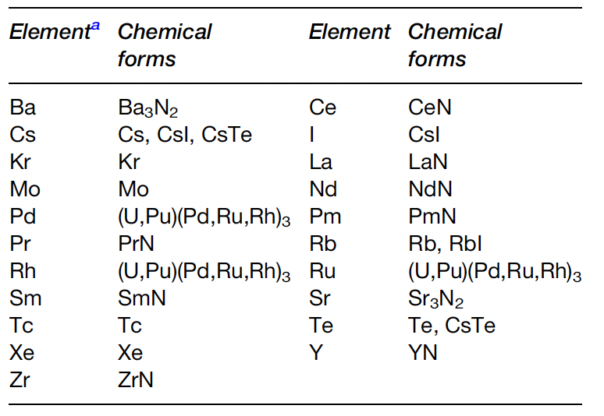
Fission Products
Fission products can form various nitride phases in the fuel matrix
Noble gases will of course not react with N, and volatile species (Cs, I, Te) will form volatile compounds
Pd, Rh, Ru, Mo, Tc form metallic precipitates
Rare earths and transition metals are dissolved in the U/Pu-N matrix
The N/U ratio was evaluated and reported to increase by 2% at a burnup of 10%
The increase in N can form U2N3 phases

Slide 4
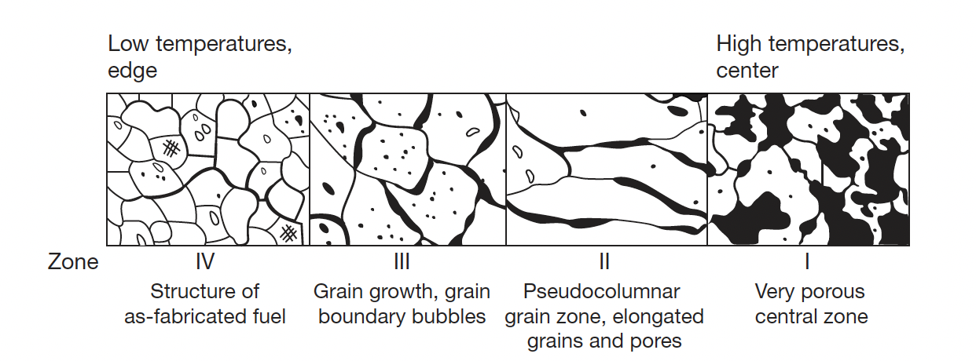
Nitride Restructuring
Because of relatively low fuel temperature and temperature gradient, the restructuring of (U,Pu)N fuel is mild in comparison with MOX fuel for fast reactors
For He bonded pins at high power, restructuring does occur with three distinct zones
Zone 1 is found in the central of the fuel pellet was characterized by very porous structure; a small central hole was sometimes observed

Slide 5
Nitride Restructuring
Zone 2 is found in MOX fuels and sometimes in carbide fuels, but NOT in UN fuels
Zone 3 displays grain growth, grain boundary bubbles, and healing of cracks
Zone 4 has the as-fabricated structure
Fission gas release is prevalent in zone 1 and zone 3, with large amount of UN swelling

Slide 6
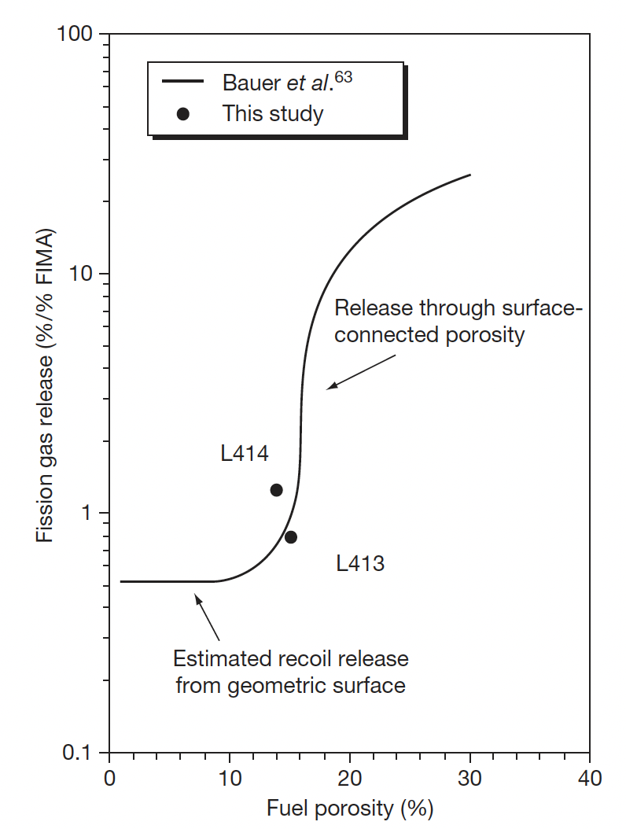
Fission Gas Release
There have been no systematic results dealing with fission gas release of nitride fuel, due to limited irradiations
It is generally known that FP gas release of nitride fuel is much lower than that of MOX fuel
Gas release will be influenced by burnup, pellet density, grain size, the characteristics of porosities, and temperature
Fuel at 4.3% FIMA

Slide 9
Swelling and FCMI
Since FG release is low, its possible that swelling is large
Volumetric swelling is caused by the accumulation of solid FP and crack formation in the pellets
The volumetric swelling rate of (U,Pu)N fuel irradiated to 9.3% FIMA was evaluated at 1.83% per FIMA% without the constraint of the cladding tube
This is considerably higher than UO2 fuels, and lower than metallic fuels
The creep rate of (U,Pu)N fuel is low in comparison with MOX or metallic fuel at operating temperatures due to a slow diffusion rate of metal atoms in nitride fuel
Thus, focus has been placed upon the degree of FCMI in UN fuels
FCMI in a general sense can be mitigated by the reduced TD and operating at a reasonable linear power (<100kW/m)

Slide 10
Reprocessing
Both hydrochemical and pyrochemical processes were proposed for the reprocessing techniques
The disposal of long-lived ¹⁴C and the recovery of expensive ¹⁵N are key topics in reprocessing
Hydrochemical processes include the direct dissolution of spent nitride fuel in HNO3 and the voloxidation of spent nitride fuel followed by the dissolution in HNO3
The product of hydrochemical reprocessing is the nitric solution of U+Pu to be converted to oxide, and then to nitride by carbothermic reduction
Pyrochemical processing is very similar to that for metallic fuel

Slide 11
Nitride Fabrication
Similar to carbide fuels, preparation of nitrides from either metallic sources or from the hydriding-dehydriding process were explored in the 1960s and remain an option for laboratory implementation
These reactions are exothermic and should be carried out slowly by temperature cycling for better control of the products
It is difficult to apply the metal or hydride route to a technological fuel production line
These processes include the nitridation of U or Pu metal in N2 or NH3 at 1073–1173 K, arc-melting of U or Pu metal under N2 pressure, nitridation of fine-grained U or Pu powder formed by the decomposition of hydrides with N2 or NH3 and direct reaction of UH3 or PuH_{2.7} with N2 or NH3

Slide 12

Carbothermic Reduction
Carbothermic reduction is the most widely used process for preparing nitride fuel
The starting material is a dioxide and carbon, and the general reaction is
The mixture of dioxide and carbon is heated in N2 gas stream, usually at 1773–1973 K
An excess amount of carbon is usually added to the mixture to reduce the oxygen content
The residual carbon is removed from the products by heating in a N2-H2 stream
The initial C/MO2 mixing ratio was historically chosen at 2.2–2.5 for the preparation of UN and (U,Pu)N
For the preparation of UN and (U,Pu)N, the atmosphere is changed to Ar or He from N2 or N2–H2 to prevent the formation of higher nitrides

Slide 13
Carbothermic Reduction
Typical impurities in nitride fuel prepared by carbothermic reduction are oxygen and carbon
The level of impurities can be kept lower than 1000–2000 ppm for both oxygen and carbon by adjusting the initial C/MO2 mixing ratio
Carbonitrides (U/Pu-C-N) have complete solubility in the MN systems, while oxides have solubility around 10%
MA-N can be manufactured in the same way, but has different C, N, and O potentials, requiring slightly different mixtures of streams
Am also has a high vapor pressure and it is a challenge to keep it from vaporizing during fabrication
This requires operating at lower temperatures for the N2 stream
Unlike carbides, Pu volatilization is not an issue

Slide 14
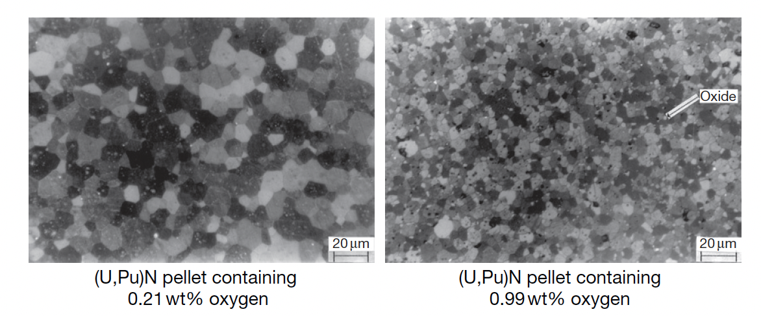
Nitride Pellets
Nitride fuel pellets are usually prepared by a classical powder metallurgical manner; the product of carbothermic reduction is ground to powder by use of a ball mill, pressed into green pellets and sintered in a furnace at 1923–2023 K
Actinide nitride powder has a low sinter-ability in comparison with that of oxide or carbide powder, which is derived from a low diffusion rate of metal atoms in mononitrides
A high sintering temperature (i.e., T>1973 K) is necessary for preparing dense UN or (U,Pu)N pellets higher than 90% TD
Oxygen impurities tend to promote the sintering of UN, but greater than 1 wt% decreases the density and results in an overly fine grain structure

Slide 15
Summary
Nitrides have a higher U density and higher thermal conductivity than oxides, with a higher melting point than carbides
Difficult fabrication, requiring atmospheric controls and enrichment of N, especially in thermal or transmutation applications
Carbothermic reduction is the primary fabrication route
Very few irradiations have been performed, none to especially high burnups
Three stages in temperature, with gap closure leading to steady state behavior
Nitride fuel undergoes restructuring, with central porous region, large grained region, and as-fabricated microstructure
FCMI is a key life limiting phenomenon due to little creep in UN fuels

Slide 16
Exam 3
This concludes our module 3
Exam will take place next Tuesday (11/2)
Will cover molten salts, carbides and nitrides

